Slide 1
Fuzzer Presentation and Discussion of DVGM
David Kennedy

Slide 2
Presentation Plan
Why use Fuzzers?
Fuzzer Implementation and Mutation Strategies
Results and some Exploitation Examples
Evaluation of the DVGM
Challenges and Possible Improvements to the Fuzzer
Questions
Notes:
So a brief plan of what this presentation will involve, we’ll start by introducing the argument for Fuzzers and why the DVGM is a good candidate for Fuzz testing. Next we’ll move onto how the fuzzer was created.
Then we’ll link the results of the Fuzz test to the DVGM and evaluate which parts of the DVGM I liked and thought were implemented well and which parts were vulnerable to injection attacks and possible patch's to stop these vulnerabilities.
Finally we’ll wrap up by quickly evaluating the fuzzer and how this could be furtherimproved to not only detect more bugs but detect bugs which pose a significant real threat to websites.
And then some questions.

Slide 3

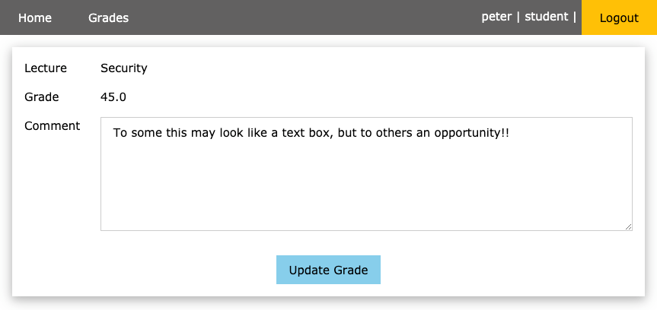
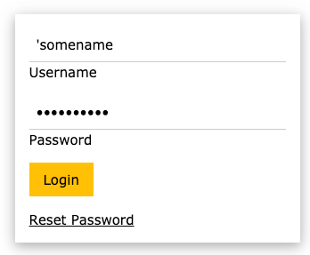
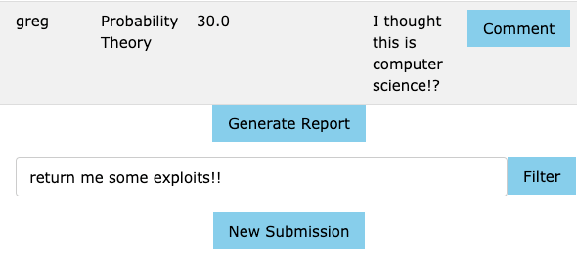
Fuzzing
An automated method of using predefined payloads and mutations, to find bugs at application endpoints.
Bugs are usually related to bad coding practices and lack of knowledge about potential exploits.
DVGM is a good candidate for Fuzz Testing because we have numerous endpoints which act as a data inputs.
The DVGM stores sensitive data such as peoples grades and assignments, we need to make sure that this data cannot be access by unauthorized users.
Notes:
Fuzzing is an automated method of using predefined payloads that common expose vulnerabilities in applications to find bugs at endpoints. These payloads are then mutated in an attempt to find even more vulnerabilities.
The bugs found during fuzz testing are generally because of poor coding practices or lack of knowledge about potential exploits. If someone didn’t know what an SQL or XSS injection attack was then its very unlikely any form of defense would be in place, unless they used servers hosted by other people who may have defenses in place and this is maybe an argument for using external hosts.
So why is the DVGM a good candidate to fuzz test, fuzzing reduces the time needed to find bugs in an application and if an application does have injection style vulnerabilities these will be found very quickly. The DVGM has numerous endpoints which are data inputs and these could have vulnerabilities. Given that the DVGM stores some sensitive data about grades and assignments its key that unauthorized users cannot access this data.

Slide 4
Implementation
In total there are 96 SQL and 235 XSS pre-defined payloads.
The script sends the correct payload type to the endpoint, the response from the request is then examined as to whether the payload was successful.
For SQL, a status code of 500 means the payload produced a server side error so this payload is considered successful.
For SQL when fuzzing the login fields if a code 200 is received along with the “Login successful” response then unauthored access has been granted.
Finally for XSS, if the XSS payload is reflected back in the response, then the XSS payload is deemed successful.
Notes:
The payloads for the fuzzer were found off the github repositories supplied with the task along with a couple more that I found which looked interesting. These will be discussed in more detail later. There are 96 SQL and 235 XSS payloads in total. The script iterates through each endpoint and determines what payload type is required, each payload for this type is then iterated through and sent as a request to the endpoint.
The response from the request is then examined to determine whether the payload was successful. There are two main SQL attack types, one where we force server side errors and these shown by the respone being status code 500 and then when we fuzz the login fields we are interesting in when we successfully manage to login in with false credentials. This is shown by when we receive a status code 200 along with the string “Login successful” being present in the response.
Finally with XSS attacks we check if the request payload has been reflected back in the response, if it has then the XSS payload is successful.

Slide 5
Mutation Strategy
If the payload was unsuccessful we apply a random small mutation to the payload and resend. If the payload fails 5 times, we move on.
Mutation Strategy 1 - XSS + SQL: Add another term to the payload.
﻿</script> becomes </script><script>alert('THIS IS AN XSS ATTACK')</script>
Strategy 2 – XSS + SQL: Swap suspicious characters such as =, ||, != with less suspicious equivalent. IE, Like, or, and, not like.
﻿"root' or '1'='1’--” becomes ﻿"root' or ‘1’ like '1'--"
Strategy 3 - SQL: Swap characters of payload around.
﻿"root' or 1=1--” becomes ﻿”-toor or 1=1’-"
Strategy 4 – SQL: Repeat a character in the payload a random number of times.
"root' or 1=1--” becomes "root’’’’’’ or 1==1--”
Notes:
If the payload was unsuccessful we can mutate it, there are 4 strategies available all 4 can be used on SQL style payloads but only the first two are used on XSS style payloads.
Strategy 1 involves adding another payload. This could bypass checks for individual snippets of malicious code or add the ‘ character to SQL payloads that may not contain this character
Strategy 2 involves swapping out suspicious terms such as the equal sign or double pipe with a less suspicious equivalent, its very rare to have double pipe in a valid user entry so characters like this have probably been blacklisted. By swapping out these terms could make the application accept the mutated payload
Strategy 3 and 4 are similar in that work by mutation the structure of the payload, this could bypass server side checks which are specifically focused on finding common SQL injection structures

Slide 6
Fuzzing Results
For the /grades endpoint where SQL injection was attempted on the cookie data returned 73 success payloads.
For the /grades endpoint where SQL injection was attempted on parameter data (the filter field) returned 96 successful payloads.
For the Login page, there were 2 payloads that successfully achieved un-authorized login.
Automated XSS did not work in this task, but manually applying XSS payloads to the endpoints did give interesting results.
The Mutation strategies showed the character shuffling to be most effective, followed by equivalent term replacement.
Notes:
So some results from the fuzz test show that for the grades endpoint where injection was attempted on cookie data returned 73 successful payloads, for the grades endpoint where we had already logged in and injecting the parameter data. Which is the filter search bar 96 successful payloads were found and many of these payloads were mutations.
For the login page endpoint 2 payloads were successful in achieving unauthorized login, this is the most concerning vulnerability found in the DVGM. Interestingly when these payloads were used, the account logged in was of peter, this is maybe because peter is the first account in the table.
Finally the XSS part of the fuzzer did not work as for the endpoints where XSS was to be tested returned 404 errors, however some of the payloads were manually applied to the endpoints and returned some interesting results.

Slide 7
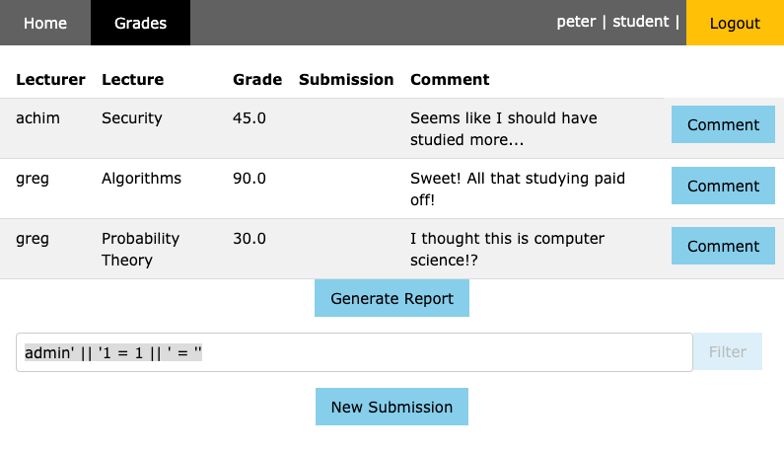
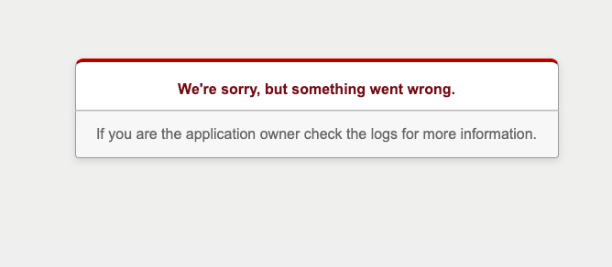
Examples
Character Shuffling Mutation example
Original payload: admin’ || '1 = 1 || ' = ’’
Result is that it causes the page to hang
Mutated payload: admin'or'1 like 1 or ' like ’’
Result…. HTTP status 500!
Notes:
So an example of when the mutation strategies were successful in turning a payload into a successful payload, in this case the double pipes and equal signs were swapped out for like and or and the mutated payload returned a status 500.

Slide 8
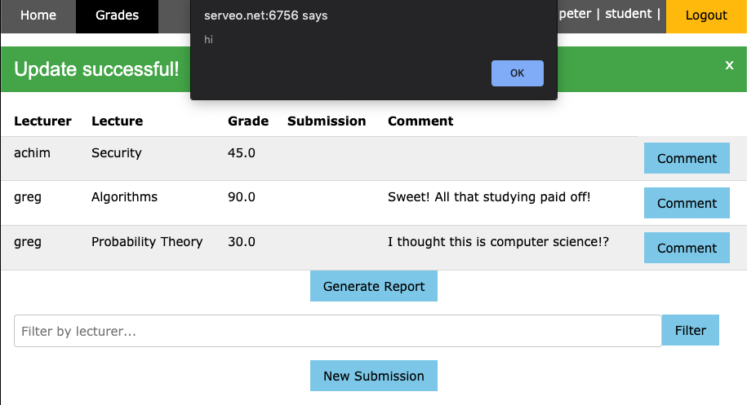
Examples
XSS problem in the grades comment page.
XSS payload: <script>alert('hi')</script>
Payload is returned by the webpage in the response so XSS payload is successful.
But there is more!
Notes:
Because there are no results returned from the automatic fuzz test, I thought I’d show some of the manual results. Using a very basic XSS attack you can see that the payload is success as it is reflected back in the response from the server. There's more to XSS injections though as they can be used to change how to page looks or even steal cookies and reuse the cookies to login.

Slide 9
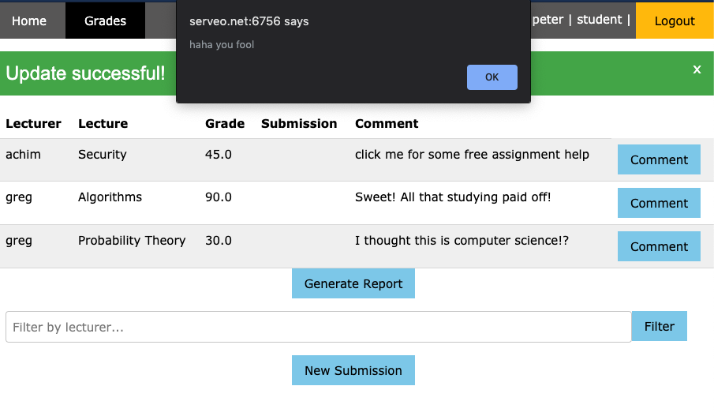
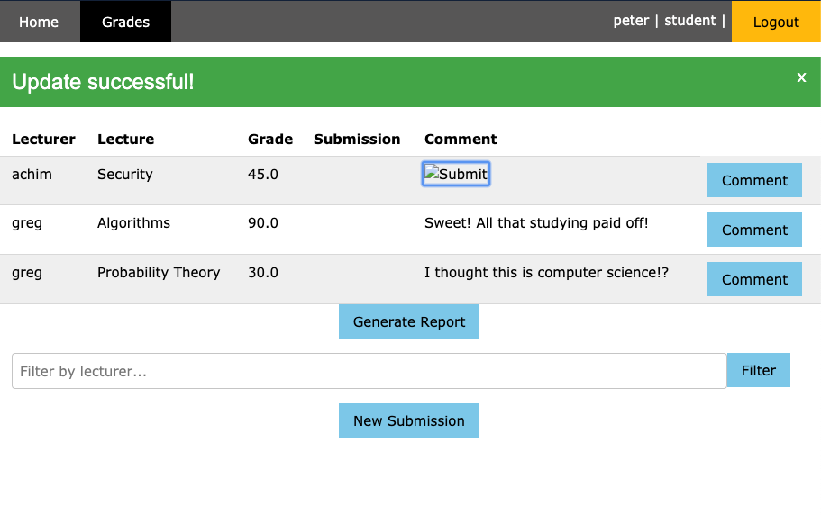
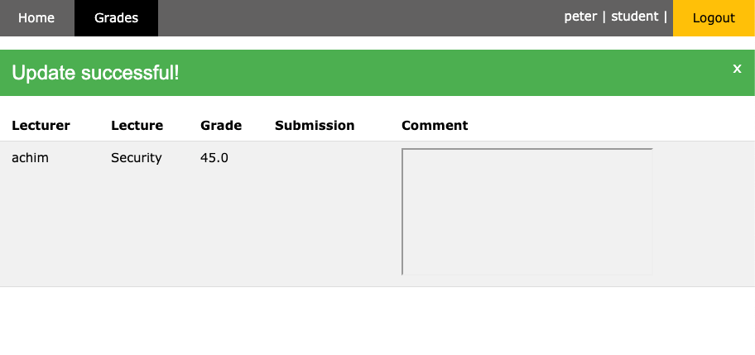
Examples
Rather than just printing alerts we could:
Add features on the page which create pop-ups every time we hover over.. very annoying!! Payload = <a onmouseover="alert(‘Haha you fool’)">click me for some free assignment help</a>
Add new buttons to the page. Payload = <input type="image" src="javascript:alert(document.cookie)”
Or alter the webpage altogether. This needs a full server reboot to undo because you can no longer see any other grades or buttons. Payload = <iframe src="javascript:alert(0)">
Notes:
So rather than just returning a boring response from the server we can add features to the page that create pop-ups every time you hover over with the mouse. We can add buttons to the page and even partially destroy the webpage. For this XSS payload I had to refresh the whole server and the same problem occurs for any account who has access to the data with the XSS. So on achims account his grades page looks the same as this.

Slide 10
DVGM Evaluation
What has been implemented well:
When the server returns a status code 500, only generic information is shown about why the request failed. This leaks little in terms of server structure to users.
That’s about it.
What has been implemented badly, key points:
Input fields have any limited to no method of sanitization
Data that originates from outside the system is trusted
There is no limit to the size of data that can be inputted
Notes:
So what do I like and dislike about the way the DVGM has been implemented, well theres a lot more to dislike than like. Its probably not intentional but I like how that if there is a server side error only the generic information is returned. Sometimes webpages return more information about the error in the response and this can give clues to attackers about the server structure.
Now what has been implemented badly is that there is very little in the way of checking user inputted data, data is blindly trusted to be non-malicious and data from outside the application is trusted such as SQL injecting the cookies. Finally its not something this fuzzer implementation can exploit but there's no limit to the size of data that can be inputted and this could lead to overflow vulnerabilities.

Slide 11
Possible DGVM Improvements
Never trust the user input, all forms of input should be considered malicious and this includes cookies.
Check user inputs for harmful terms but even better could use prepared statements where instead of inserting values directly, the database is sent a query whereby the database knowns exactly what the query is doing. This would limit SQL attacks but XSS is more difficult.
One way to limit XSS attacks is to stop applications from outputting data received as an input directly to the browser.
Limit the size of data that can be inputted to the login fields to stop overflow attacks
Notes:
So we need to stop trusting user inputs and consider all inputs to be capable of malicious intent. So on each data input field we could check for suspicious terms but we know that this a relatively week method of stopping injection attacks and a better way is to use prepared statements whereby along with the request we send information to the database about what exactly the request is doing, so rather than running the SQL payload it would say search as to whether the payload existed as a user.
XSS is more difficult to stop because if we have a rich text input such as a comment box its difficult to only filter out XSS terms whilst not filtering out valid terms , so we could instead check the response from the server to see if it looks like an XSS attack and if it does then go and remove the XSS payload from the database.

Slide 12
Problems with the Fuzzer and Improvements
Main problem with the Fuzzer is that automated XSS didn’t work, although manually it was found that some of the payloads did work. Could not fully utilize mutation strategies for XSS.
There are more endpoints in the application that are of interest such as the reset password fields and lecturer accounts. Vulnerabilities in lecturer or admin accounts have the potential to cause more damage as these account types have higher privileges.
This fuzzer requires manually adding in endpoints, a fully automated system would also have a crawler to locate and add endpoints automatically.
Notes:
Obviously the main problem is the lack of automatic XSS fuzzing and so could not find the true extent of the XSS vulnerability problems within the DVGM. So fixing this would be a priority for improving the fuzzer. Also there are some endpoints that were not fuzz tested and are of interest such as the password reset form and other account types. Lecturers and admin have higher privileges and the if an XSS style attack which altered the page was carried out as a lecturer then many more people would be exposed to the attack.
Also to make the fuzzer truly automatic we could add a crawler than finds endpoints within the application rather than manually adding them, a crawler would also solve the problem above of not testing all the endpoints.

Slide 13
Any Questions

